Slide 1
Entity/Relationship Modelling
Database Systems

Slide 2
In This Lecture
Entity/Relationship models
  Entities and Attributes
  Relationships
  Attributes
  E/R Diagrams
For more information
  Connolly and Begg chapter 11
  Ullman and Widom chapter 2
Entity Relationship Modelling

Slide 3
Data Modeling
Data modeling is often the first step in database design as the designers first create a conceptual model of how data items relate to each other. Data modeling involves a progression from conceptual model to logical model to physical schema.
Data modeling refers to describing the relationship between entities.
Models can be built for existing systems as a way to better understand those systems, or for proposed systems as a way to document business requirements or technical designs.
One way to structure unstructured problems is to draw models.

Slide 4
Categories of data models
Conceptual (high-level, semantic) data models: Provide concepts that are close to the way many users perceive data. (Also called entity-based or object-based data models.)
Logical Data Models (LDMs): Entity types, data attributes and relationships between entities
Physical Data Models: Describes HOW the system will be implemented
using a specific DBMS.

Slide 5
Entities
An entity might be
An object with physical existence. E.g. a lecturer, a student, a car
An object with conceptual existence. E.g. a course, a job, a position
Entity Type: The entity type can be defined as a name/label assigned to items/objects that exist in an environment and that have similar properties. Collection of similar entities define a type of an entity.
For example Students is a Entity Type.
Entity Instance: Ahmed is a Entity instance of Entity Type Student.

Slide 6
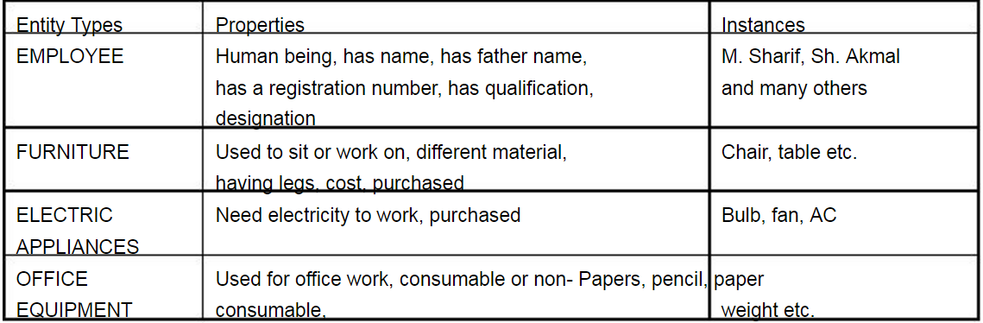
Entities

Slide 7
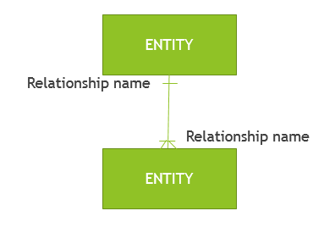
A data model consists of entities related to each other on a diagram:
Data Model Element | Definition
Entity | A real world thing or an interaction between 2 or more real world things.
Attribute | The atomic pieces of information that we need to know about entities.
Relationship | How entities depend on each other in terms of why the entities depend on each other (the relationship) and what that relationship is (the cardinality of the relationship).

Slide 8
Example:
Given that …
“Customer” is an entity.
“Product” is an entity.
For a “Customer” we need to know their “customer number” attribute and “name” attribute.
For a “Product” we need to know the “product name” attribute and “price” attribute.
“Sale” is an entity that is used to record the interaction of “Customer” and “Product”.

Slide 9
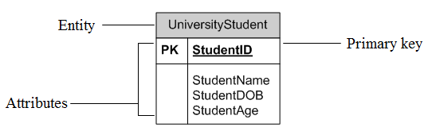
E-R model (Basic Concepts)
Entity relationship model is considered as a mostly used Data model.
Entity Relationship Diagrams (ERD) as this is the most widely used
ERDs have an advantage in that they are capable of being normalized
Represent entities as rectangles
List attributes within the rectangle

Slide 10
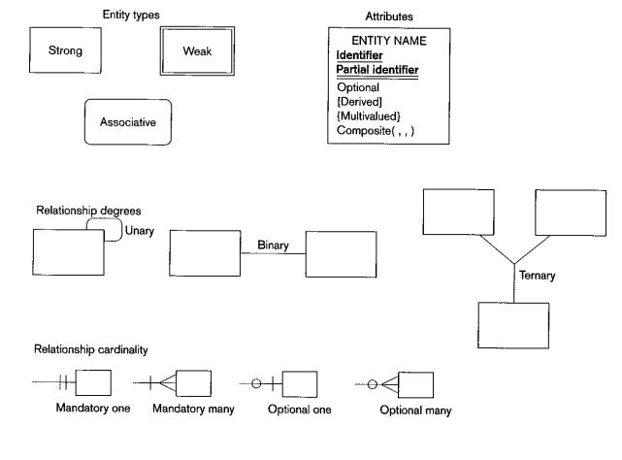
E-R Components

Slide 11
Attributes & Their Types
Entities are represented by means of their properties, called attributes. All attributes have values. For example, a student entity may have name, class, and age as attributes.
Simple or Atomic Attributes: This is a type of attributes which can’t be divided further. For example Age is a simple attribute.
Composite Attributes: These are the types of attributes which can be divided further. Such as name of a person. Which can be divided into first name, last name, middle name.
Single valued attributes: Those attributes which have single value for an entity such as age, Social security number.
Multivalued attributes: Multivalued attributes can have multiple values. For instance a person may have multiple phone numbers, multiple degrees etc. Multivalued attributes are shown by a double line connecting to the entity in the ER diagram.
Stored and Derived attributes: Attributes whose values are derived from other related attributes or entities. Such as student age is derived by subtracting today date from his DOB. Hence student age is Derived attribute and DOB is stored attribute.

Slide 12
Entity/Relationship Modelling
E/R Modelling is used for conceptual design
  Entities - objects or items of interest
  Attributes - facts about, or properties of, an entity
  Relationships - links between entities
Example
  In a University database we might have entities for Students, Modules and Lecturers. Students might have attributes such as their ID, Name, and Course, and could have relationships with Modules (enrolment) and Lecturers (tutor/tutee)
Entity Relationship Modelling

Slide 13
Entity/Relationship Diagrams
E/R Models are often represented as E/R diagrams that
  Give a conceptual view of the database
  Are independent of the choice of DBMS
  Can identify some problems in a design
Lecturer
ID
Name
Course
Tutors
Student
Module
Studies
Entity Relationship Modelling

Slide 14
Entities
Entities represent objects or things of interest
  Physical things like students, lecturers, employees, products
  More abstract things like modules, orders, courses, projects
Entities have
  A general type or class, such as Lecturer or Module
  Instances of that particular type, such as Steve Mills, Natasha Alechina are instances of Lecturer
  Attributes (such as name, email address)
Entity Relationship Modelling

Slide 15
Diagramming Entities
In an E/R Diagram, an entity is usually drawn as a box with rounded corners
The box is labelled with the name of the class of objects represented by that entity
Lecturer
ID
Name
Course
Tutors
Student
Module
Studies
Entity Relationship Modelling

Slide 16
Attributes
Attributes are facts, aspects, properties, or details about an entity
  Students have IDs, names, courses, addresses, …
  Modules have codes, titles, credit weights, levels, …
Attributes have
  A name
  An associated entity
  Domains of possible values
  Values from the domain for each instance of the entity they are belong to
Entity Relationship Modelling

Slide 17
Diagramming Attributes
In an E/R Diagram attributes may be drawn as ovals
Each attribute is linked to its entity by a line
The name of the attribute is written in the oval
Lecturer
ID
Name
Course
Tutors
Student
Module
Studies
Entity Relationship Modelling

Slide 18
Relationships
Relationships are an association between two or more entities
  Each Student takes several Modules
  Each Module is taught by a Lecturer
  Each Employee works for a single Department
Relationships have
  A name
  A set of entities that participate in them
  A degree - the number of entities that participate (most have degree 2)
  A cardinality ratio
Entity Relationship Modelling

Slide 19
Cardinality Ratios
Each entity in a relationship can participate in zero, one, or more than one instances of that relationship
This leads to 3 types of relationship…
One to one (1:1)
  Each lecturer has a unique office
One to many (1:M)
  A lecturer may tutor many students, but each student has just one tutor
Many to many (M:M)
  Each student takes several modules, and each module is taken by several students
Entity Relationship Modelling

Slide 20
Diagramming Relationships
Relationships are links between two entities
The name is given in a diamond box
The ends of the link show cardinality
Lecturer
ID
Name
Course
Tutors
Student
Module
Studies
One
Many
Entity Relationship Modelling

Slide 21
Removing M:M Relationships
Many to many relationships are difficult to represent
We can split a many to many relationship into two one to many relationships
An entity represents the M:M relationship
Student
Student
Has
Studies
Enrolment
In
Module
Module
Entity Relationship Modelling

Slide 22
Making E/R Models
To make an E/R model you need to identify
  Enitities
  Attributes
  Relationships
  Cardinality ratios
from a description
General guidelines
  Since entities are things or objects they are often nouns in the description
  Attributes are facts or properties, and so are often nouns also
  Verbs often describe relationships between entities
Entity Relationship Modelling

Slide 23
Example
A university consists of a number of departments. Each department offers several courses. A number of modules make up each course. Students enrol in a particular course and take modules towards the completion of that course. Each module is taught by a lecturer from the appropriate department, and each lecturer tutors a group of students
Entity Relationship Modelling

Slide 24
Example - Entities
A university consists of a number of departments. Each department offers several courses. A number of modules make up each course. Students enrol in a particular course and take modules towards the completion of that course. Each module is taught by a lecturer from the appropriate department, and each lecturer tutors a group of students
Entity Relationship Modelling

Slide 25
Example - Relationships
A university consists of a number of departments. Each department offers several courses. A number of modules make up each course. Students enrol in a particular course and take modules towards the completion of that course. Each module is taught by a lecturer from the appropriate department, and each lecturer tutors a group of students
Entity Relationship Modelling

Slide 26
Example - E/R Diagram
Entities: Department, Course, Module, Lecturer, Student
Department
Course
Module
Lecturer
Student
Entity Relationship Modelling

Slide 27
Example - E/R Diagram
Each department offers several courses
Offers
Department
Course
Module
Lecturer
Student
Entity Relationship Modelling

Slide 28
Example - E/R Diagram
A number of modules make up each courses
Offers
Department
Course
Includes
Module
Lecturer
Student
Entity Relationship Modelling

Slide 29
Example - E/R Diagram
Students enrol in a particular course
Offers
Department
Course
Includes
Module
Lecturer
Enrols In
Student
Entity Relationship Modelling

Slide 30
Example - E/R Diagram
Students … take modules
Offers
Department
Course
Includes
Module
Lecturer
Takes
Enrols In
Student
Entity Relationship Modelling

Slide 31
Example - E/R Diagram
Each module is taught by a lecturer
Offers
Department
Course
Includes
Module
Teaches
Lecturer
Takes
Enrols In
Student
Entity Relationship Modelling

Slide 32
Example - E/R Diagram
a lecturer from the appropriate department
Offers
Department
Employs
Course
Includes
Module
Teaches
Lecturer
Takes
Enrols In
Student
Entity Relationship Modelling

Slide 33
Example - E/R Diagram
each lecturer tutors a group of students
Offers
Department
Employs
Course
Includes
Module
Teaches
Lecturer
Takes
Enrols In
Student
Tutors
Entity Relationship Modelling

Slide 34
Example - E/R Diagram
Offers
Department
Employs
Course
Includes
Module
Teaches
Lecturer
Takes
Enrols In
Student
Tutors
Entity Relationship Modelling

Slide 35
Entities and Attributes
Sometimes it is hard to tell if something should be an entity or an attribute
  They both represent objects or facts about the world
  They are both often represented by nouns in descriptions
General guidelines
  Entities can have attributes but attributes have no smaller parts
  Entities can have relationships between them, but an attribute belongs to a single entity
Entity Relationship Modelling

Slide 36
Example
We want to represent information about products in a database. Each product has a description, a price and a supplier. Suppliers have addresses, phone numbers, and names. Each address is made up of a street address, a city, and a postcode.
Entity Relationship Modelling

Slide 37
Example - Entities/Attributes
Entities or attributes:
    product
    description
    price
    supplier
    address
    phone number
    name
    street address
    city
    postcode
Products, suppliers, and addresses all have smaller parts so we can make them entities
The others have no smaller parts and belong to a single entity
Entity Relationship Modelling

Slide 38
Example - E/R Diagram
Price
Description
Product
Street address
Name
Supplier
Address
City
Phone number
Postcode
Entity Relationship Modelling

Slide 39
Example - Relationships
Each product has a supplier
  Each product has a single supplier but there is nothing to stop a supplier supplying many products
  A many to one relationship
Each supplier has an address
  A supplier has a single address
  It does not seem sensible for two different suppliers to have the same address
  A one to one relationship
Entity Relationship Modelling

Slide 40
Example - E/R Diagram
Price
Description
Product
Has A
Street address
Name
Supplier
Has A
Address
City
Phone number
Postcode
Entity Relationship Modelling

Slide 41
Example - E/R Diagram
Price
Description
Product
Has A
Name
Supplier
City
Phone number
Postcode
Street address
Entity Relationship Modelling

Slide 42
Making E/R Diagrams
From a description of the requirements identify the
  Entities
  Attributes
  Relationships
  Cardinality ratios of the relationships
Draw the E/R diagram and then
  Look at one to one relationships as they might be redundant
  Look at many to many relationships as they might need to be split into two one to many links
Entity Relationship Modelling

Slide 43
“A database will be made to store information about patients in a hospital. On arrival, each patient’s personal details (name, address, and telephone number) are recorded where possible, and they are given an admission number. They are then assigned to a particular ward (Accident and Emergency, Cardiology, Oncology, etc.). In each ward there are a number of doctors and nurses. A patient will be treated by one doctor and several nurses over the course of their stay, and each doctor and nurse may be involved with several patients at any given time.”
Entity Relationship Modelling

Slide 44
Classification of entities
Entities types are classified into two types.
Weak Entity Types
Strong Entity Types
These types will be discussed after Keys Lecture

Slide 45
So far……!!!!
Identify the entities, attributes, relationships, and cardinality ratios from the description.
Draw an entity-relationship diagram showing the items you identified.
Many-to-many relationships are hard to represent in SQL tables. Explain why many-to-many relationships cause problems in SQL tables, and show how these problems may be overcome.
Entity Relationship Modelling

